Slide 1
Interaction design in retail
Michelangelo Guarise

Slide 2
Brand Style Guide
A brand style guide is a document that codifies how an organization presents itself to the world
it’s a reference tool that helps maintain consistency by demonstrating what a brand looks, feels and sounds like
In the absence of a unifying style guide, incorrect or inconsistent content and branding may be applied

Slide 3
Brand Style Guide
Mission and Vision (Mission statement)
Target audience
Brand personality
Core values

Slide 4
Brand Style Guide: case studies
Urban outfitters: https://issuu.com/themarkit/docs/urban_outfitters_brand_book_final_p_d1cb1321abd5a6
Medium:
https://www.behance.net/gallery/7226653/Medium-Brand-Development
Barre and Soul:
https://issuu.com/corinnealexandra/docs/bas-brandguide
I love New York:
https://issuu.com/lukaszkulakowski/docs/8278452-i-love-new-york-brand-guide

Slide 5
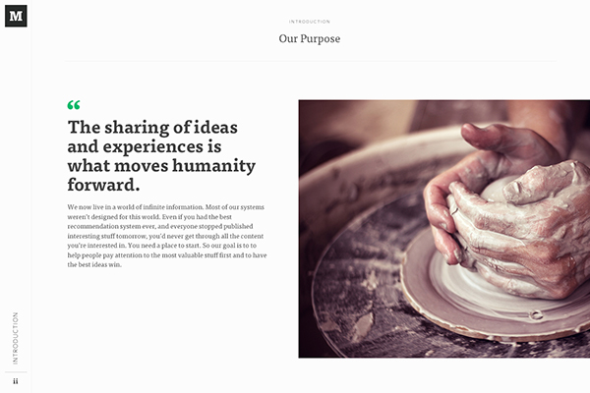
Brand Style Guide (Medium mission)

Slide 6
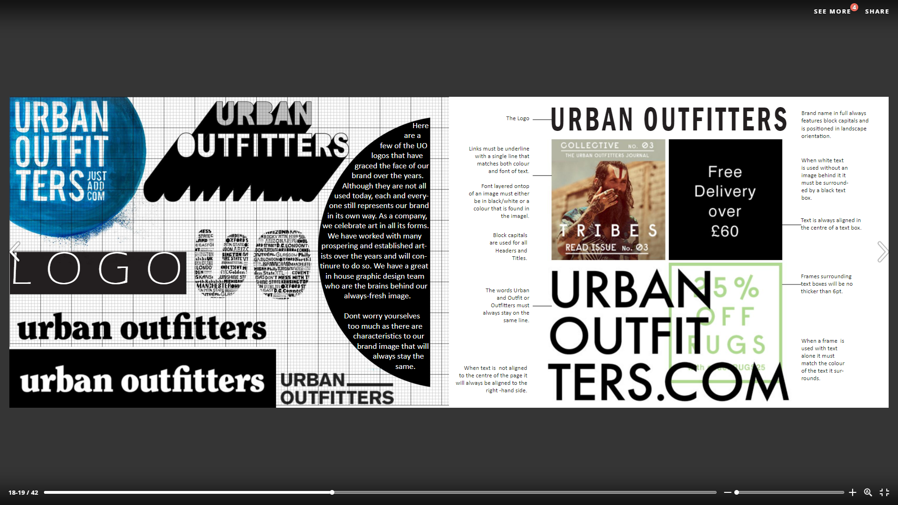
Brand Style Guide (UO Logo)

Slide 7
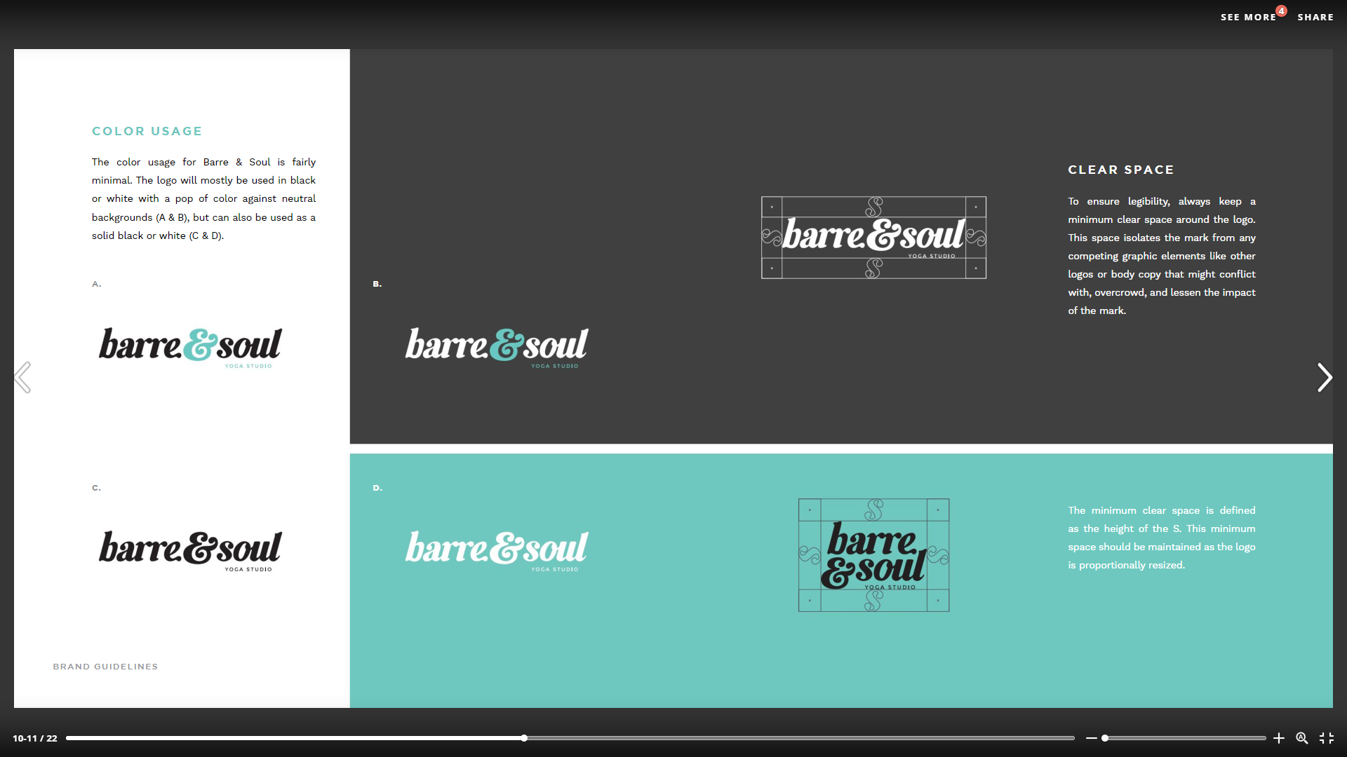
Brand Style Guide (B&S Logo & Colour)

Slide 8
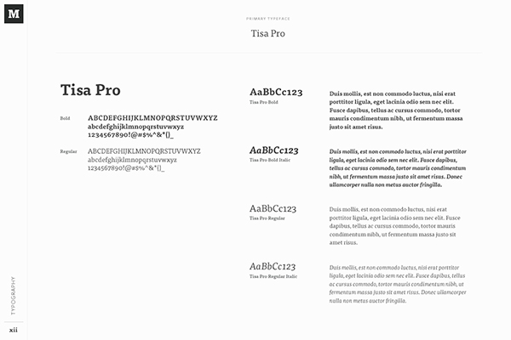
Brand Style Guide (Medium Typography)

Slide 9
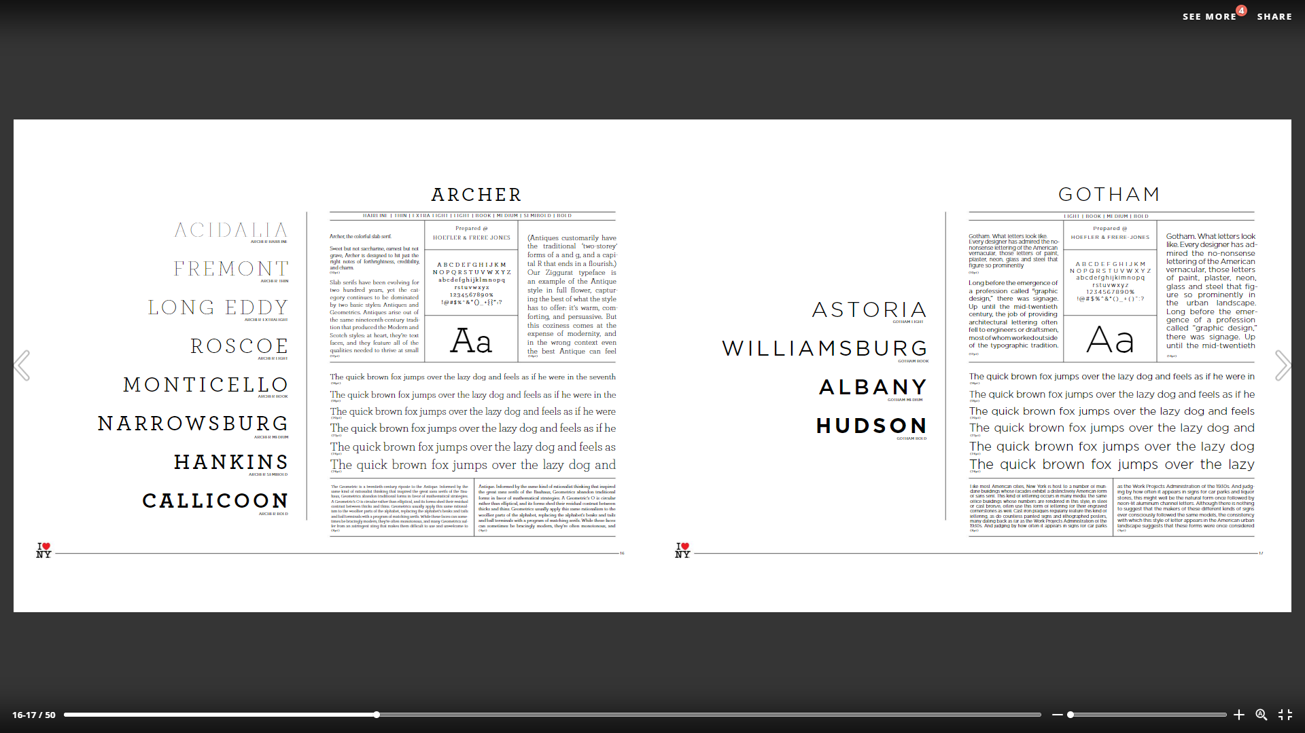
Brand Style Guide (I love NY Typography)

Slide 10
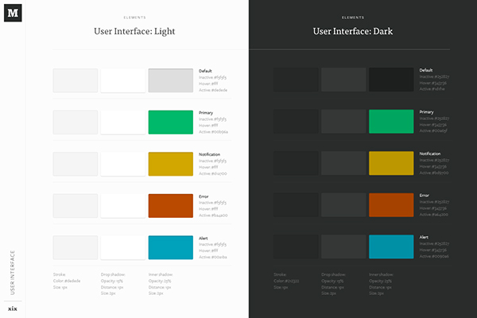
Brand Style Guide (Medium Colours)

